Slide 1
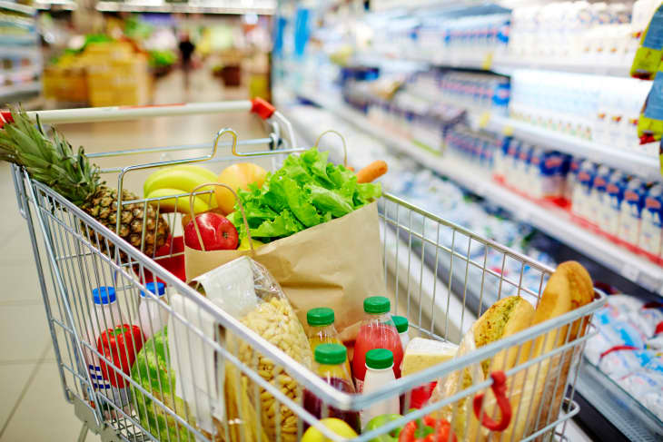
Marketing and Retail Analysis - Project 2 Grocery Store Data
By: Kavin Bharathi

Slide 2

Agenda
Problem Statement
Exploratory Data Analysis
Market Basket Analysis
Association Identification
Recommendations

Slide 3

Problem Statement
A grocery store shared the transactional data with you. Your job is to conduct a thorough analysis of Point of Sale (POS) data, identify the most commonly occurring sets of items in the customer orders, and provide recommendations through which a grocery store can increase its revenue by popular combo offers & discounts for customers.

Slide 4

Exploratory Data Analysis
Executive Summary of the Data
Trend Analysis
Summary

Slide 5

Executive Summary of the Data
Data – Available from 1-Jan-2018 to 26-Feb-2020
Objective - The project entails conducting an extensive analysis of Point of Sale (POS) data to formulate recommendations aimed at enhancing revenue for a grocery store. These recommendations will focus on implementing popular combo offers and discounts to attract customers.
Dataset – 20641 Rows and 3 columns.
Missing Values – None
Duplicate Values – 4730 values, which indicates the same product bought in multiple quantities.
Market Basket Analysis - Market Basket Analysis, utilizing association rules, was conducted to analyze patterns in customer purchasing behavior. This analysis facilitated the identification of frequently co-purchased products, enabling the creation of attractive offers for customers. By leveraging these insights, the grocery store can craft enticing deals and discounts on commonly associated items, thereby stimulating sales and aligning with customer preferences effectively.

Slide 6
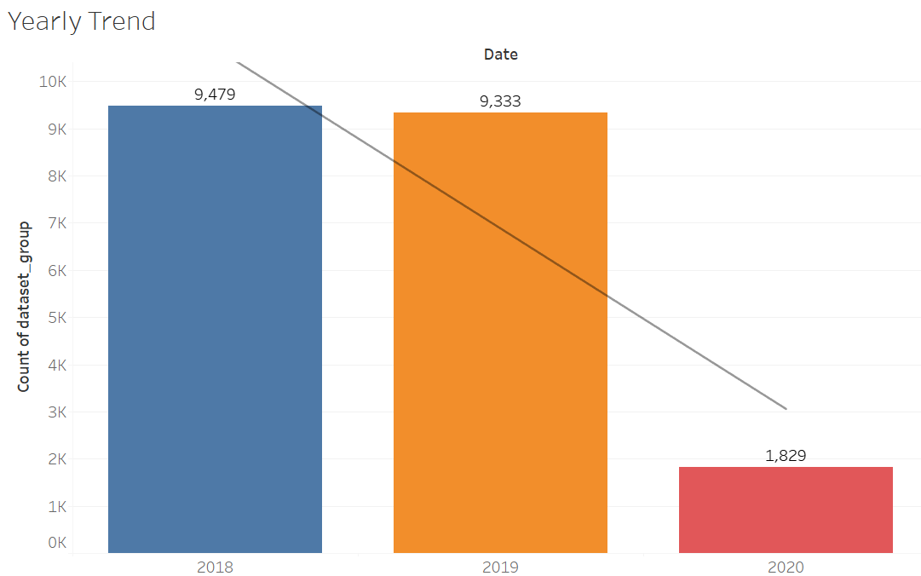
Trend Analysis

Slide 7
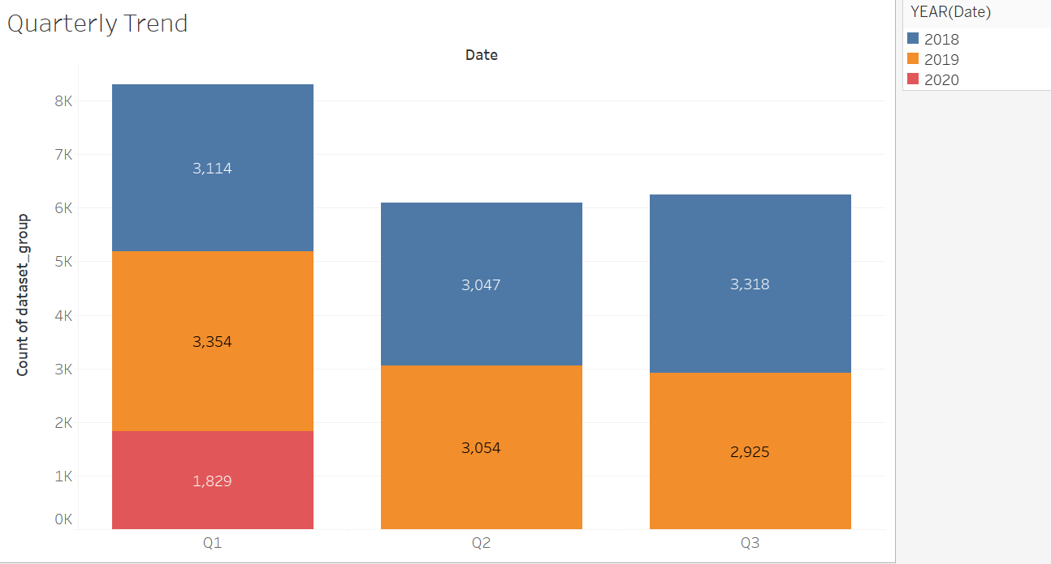
Quarterly Trend
Quarter 1 shows the higher numbers and 2019 Q1 sales was the highest among all followed by 2018 Q3and Q1.

Slide 8
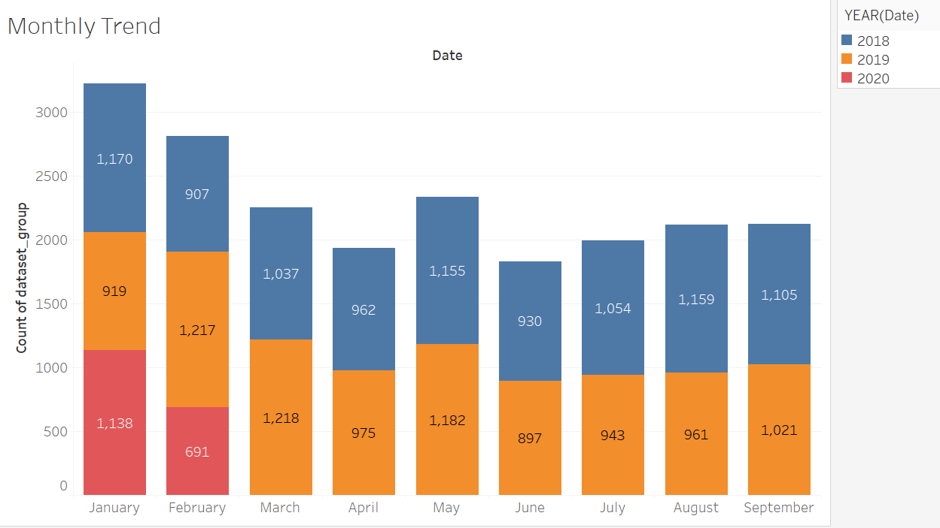
Monthly Trend
In 2018, most number of products were sold in the month of January.
2019 March has the most number of sales for the year.

Slide 9
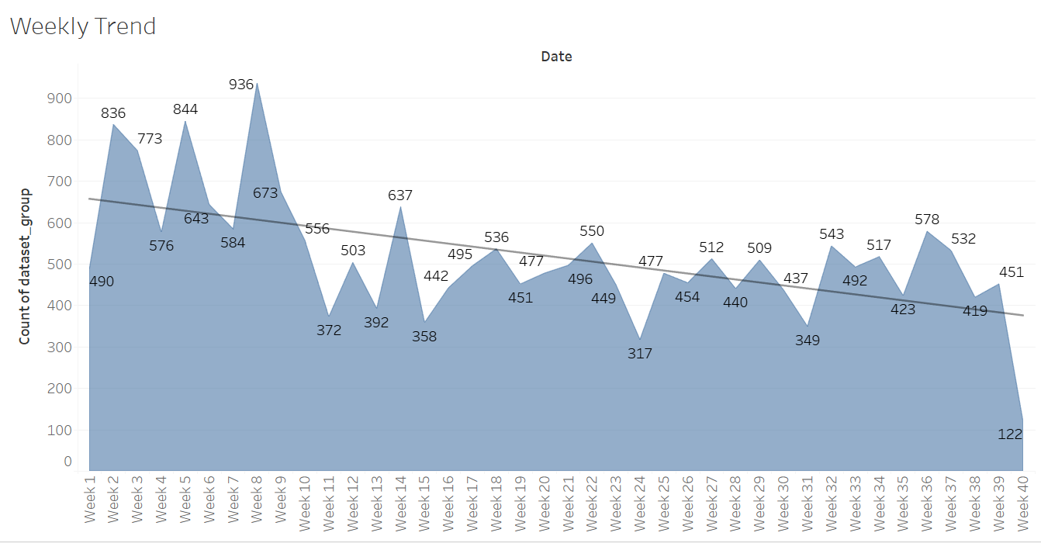
Weekly Trend

Slide 10
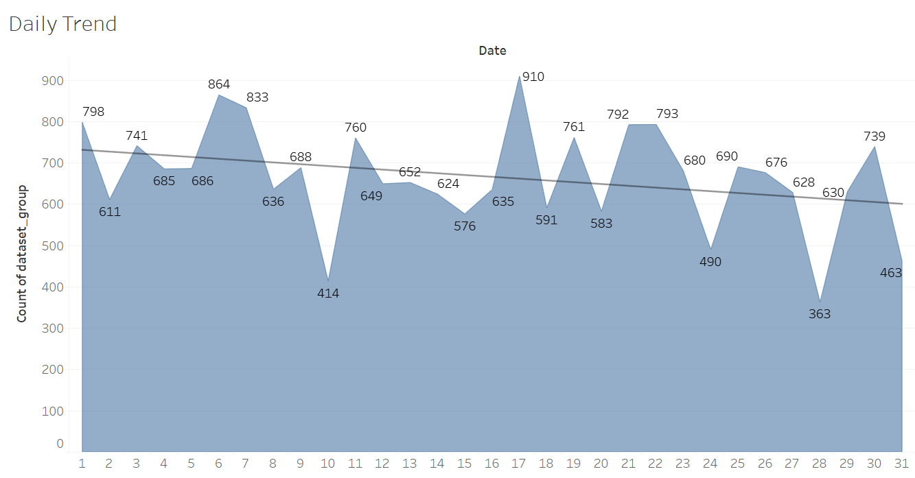
Daily Trend

Slide 11
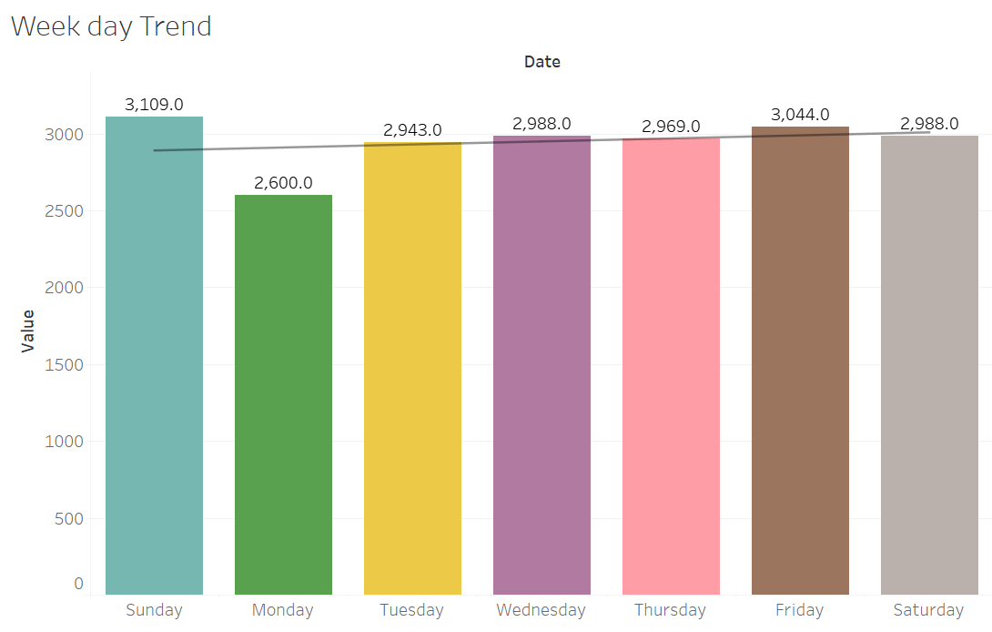
Week Day Trend
Sales has been consistent across all the days of the week.
Sundays are the highest grossing and Mondays are the lowest.

Slide 12
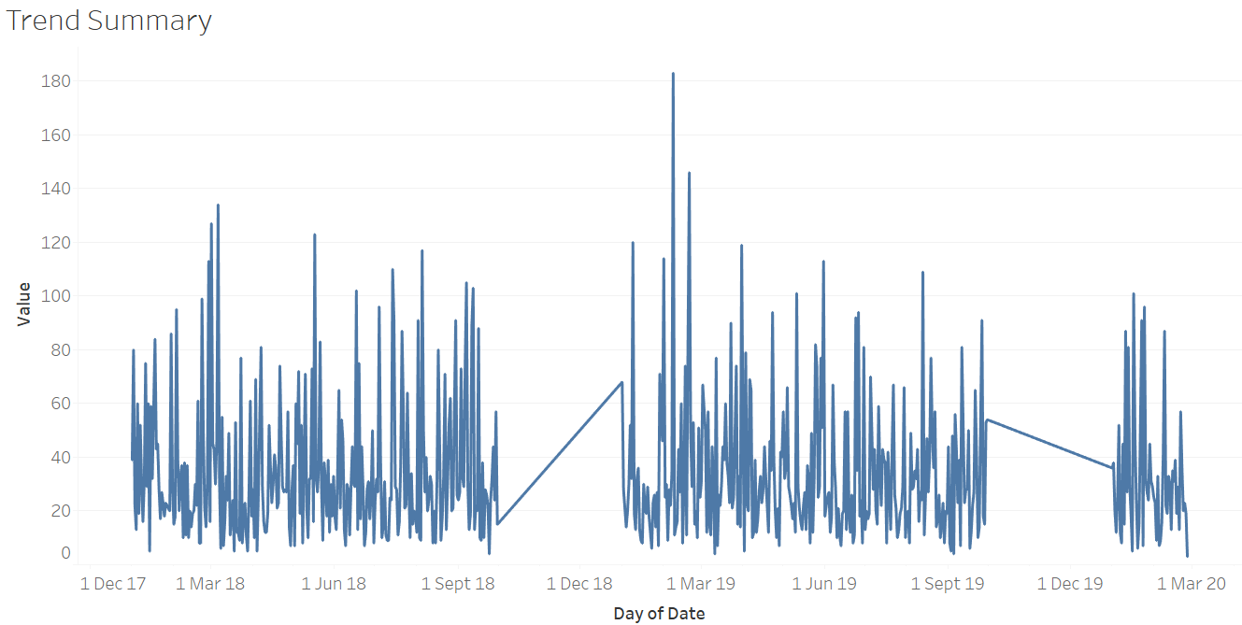
Trend Summary

Slide 13
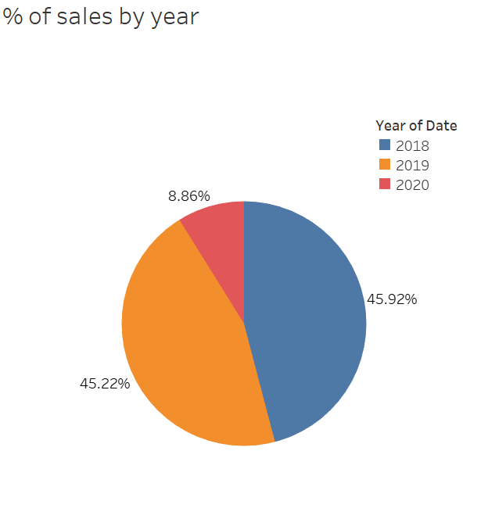
Sales % by Year

Slide 14
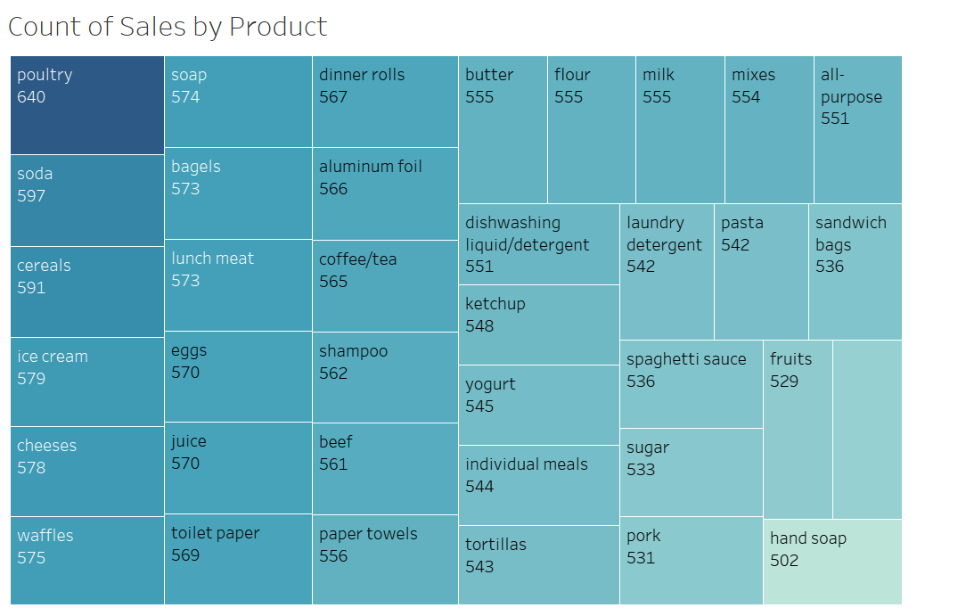
Sales By Product

Slide 15
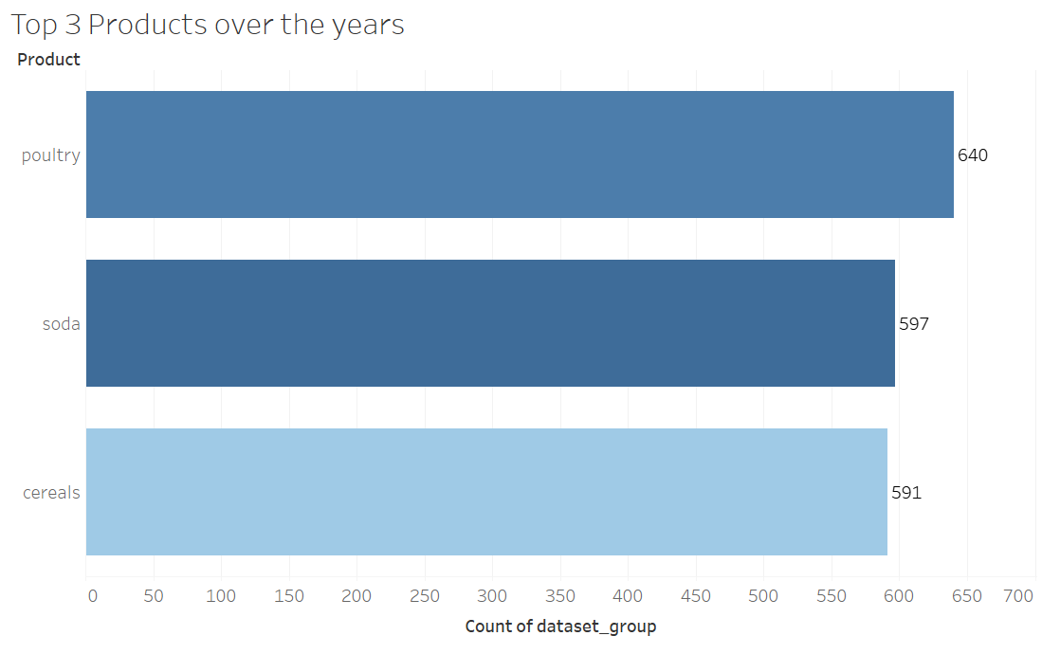
Top 3 Products over years

Slide 16
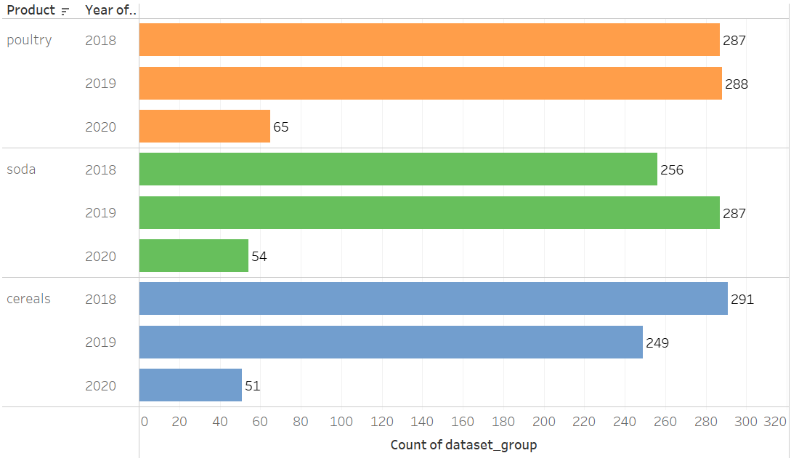
Top Three Product Sales Over the years

Slide 17
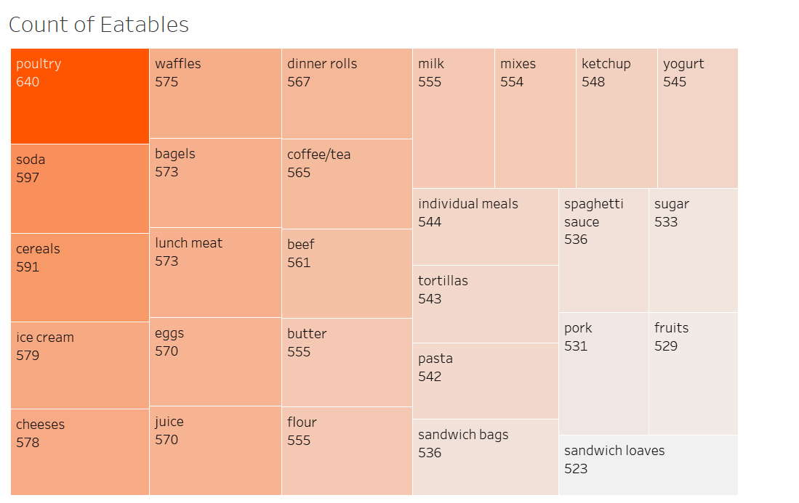
Count of Eatables

Slide 18
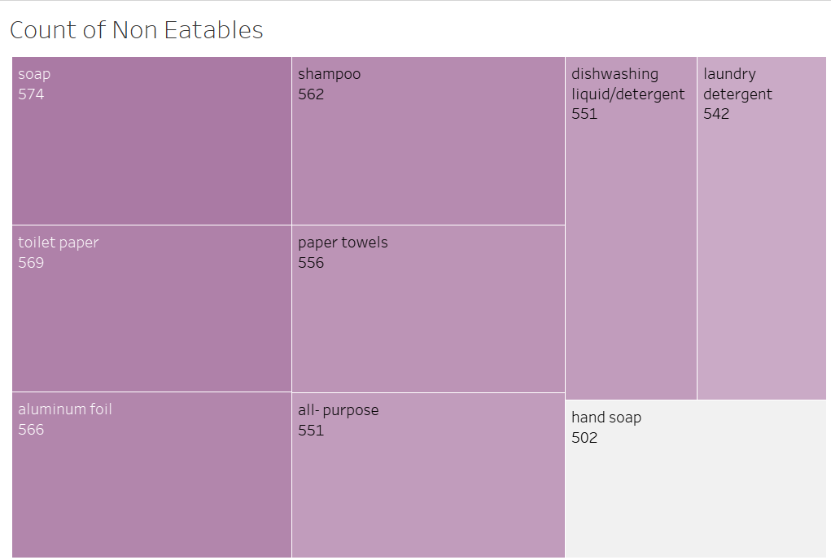
Count of Non Eatables

Slide 19
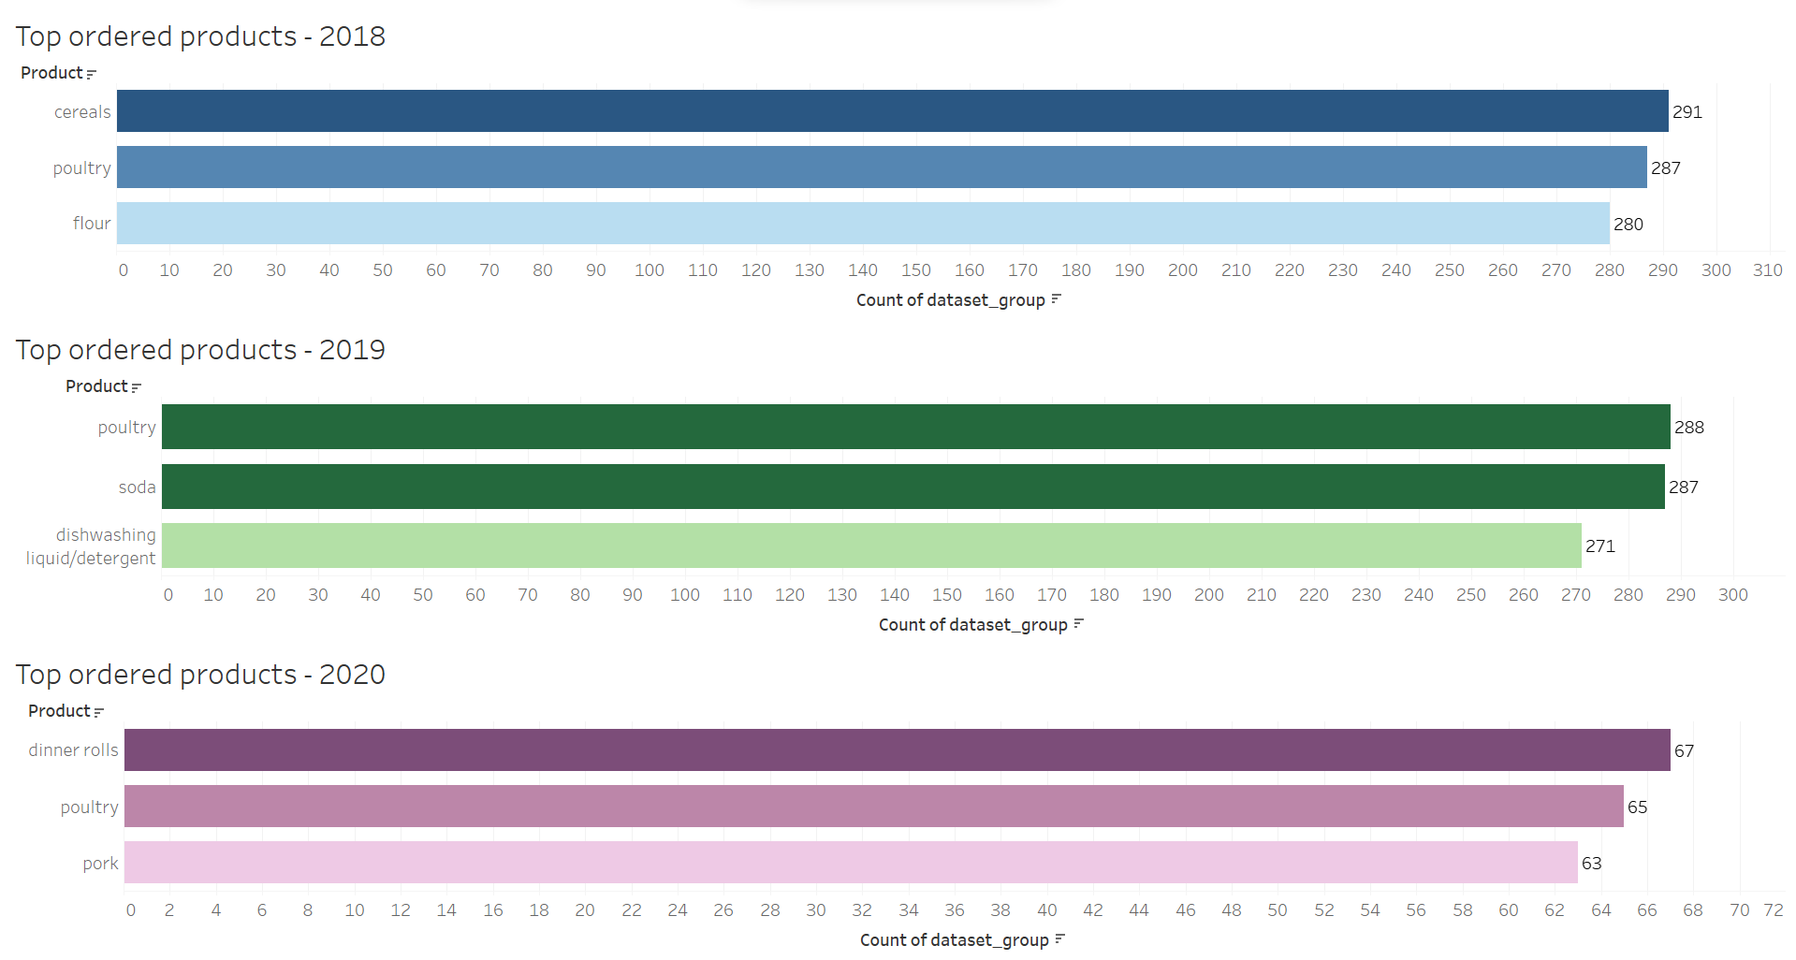
Top Ordered Products for Each Year

Slide 20

Summary
The top-selling products over the years were cereals, poultry, and soda.
For January and February 2020, the top-selling items were dinner rolls, poultry, and pork.
Consistently high-selling products throughout the years include poultry, cereals, and soda.
The most popular non-edible products are soap and toilet paper, while hand soap sells the least.
Among edible items, poultry, soda, and cereals are the best sellers, while pork, fruits, and sandwich loaves are the least popular.
Sales peak on Sundays and are lowest on Mondays.
In 2018, January saw the highest sales, while February had the lowest. In 2019, March had the highest sales, while January had the lowest.
The highest sales occurred in Q1 2019 and Q3 2018.
The number of products sold in Q2 is roughly the same in 2019 and 2018.
Sales in 2020 are lower, likely due to the data only being available until February 26th.

Slide 21
Market Basket Analysis
What is Market Basket Analysis and its uses?
Market basket analysis is a data mining technique used to identify relationships between products that are frequently purchased together. It helps businesses understand customer purchasing patterns and can be used to optimize product placement, cross-selling, and targeted marketing strategies. By analyzing which items are commonly bought together, businesses can enhance their sales strategies and improve customer satisfaction.
Association Rules:
Association rules are foundational to Market Basket Analysis, determining the relationships between items purchased together. These rules are quantified using metrics like support, confidence and lift to identify meaningful associations between products.
Support: Support quantifies the frequency of occurrence of itemsets in the dataset, indicating how often specific combinations of items are purchased together. It helps identify significant associations by setting a minimum threshold for support values.
Support = Total number of transactions / Transactions containing both A and B
Confidence: Confidence measures the reliability of association rules by assessing the likelihood that an item B is purchased when item A is bought. Higher confidence values signify stronger associations between items, aiding in understanding customer behavior and preferences.
Confidence = Support(A∩B) / Support(A)
Lift: Lift evaluates the strength of association between two items beyond what would be expected by chance. It indicates whether an association rule is significant and provides insights into the effectiveness of targeting specific product combinations in marketing strategies.
Lift = Support(A∩B) / Support(A)×Support(B)​

Slide 22
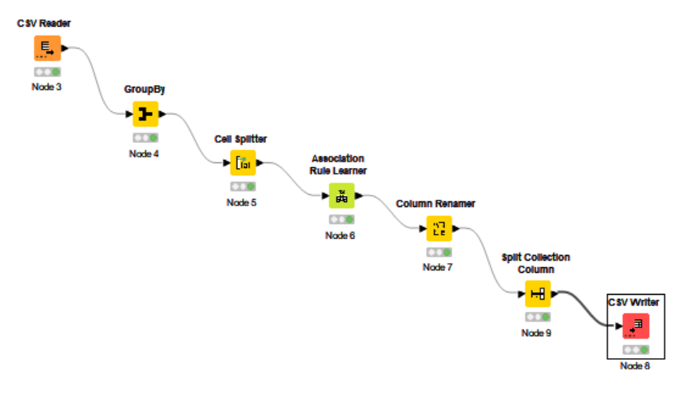
Knime Workflow

Slide 23
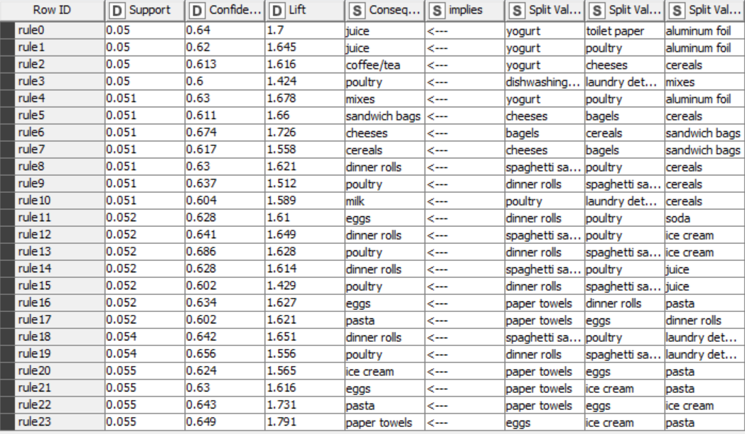
Association Identification
Threshold values –
Support of Minimum: 0.05
Maximum Item Set Length : 10
Minimum Confidence Level:0.6
For the given dataset, 24 association rules have been derived using the above threshold values, each providing insights into the relationships between different items purchased together by customers.
Support value greater than 0.05 indicates the popularity of item among the overall group whichever is higher is shown.
Confidence over 0.6 shows the probability of the combo which works very good.
Lift > 1 reflects the positive relationship between the combination of items.
These rules offer valuable information for optimizing marketing strategies, such as creating bundled offers and targeted promotions, to enhance sales and customer satisfaction.

Slide 24

Recommendations
To encourage customers to buy more items at once, consider implementing a "Buy Two Get One Free" offer on yogurt, poultry, and aluminum foil.
Additionally, create combo deals like purchasing cereals, bagels, and sandwich bags together at a discounted rate.
Offering discounts on mixes when purchased with yogurt, poultry, or aluminum foil can further incentivize larger purchases.
Moreover, providing discounts on dinner rolls when bought with spaghetti sauce or poultry can entice customers to explore complementary items.
Consider bundling paper towels, toilet paper, and tissues for a discounted price to enhance customer value.
Promote these offers through in-store signage, ads, and social media to maximize awareness and sales.

Slide 25


